Slide 1
Graph Algorithms
Bellman Ford Algorithm

Slide 2
Given a graph and a source vertex src in the graph, find the shortest paths from src to all vertices in the given graph. The graph may contain negative weight edges.
We have discussed Dijkstra’s algorithm for this problem.
Dijkstra’s algorithm is a Greedy algorithm and the time complexity is O((V+E)LogV) (with the use of the Fibonacci heap).
Dijkstra doesn’t work for Graphs with negative weights, Bellman-Ford works for such graphs.
Bellman-Ford is also simpler than Dijkstra and suites well for distributed systems. But time complexity of Bellman-Ford is O(V * E), which is more than Dijkstra.

Slide 3
Steps for finding the shortest distance to all vertices from the source using the Bellman-Ford algorithm:
This step initializes distances from the source to all vertices as infinite and distance to the source itself as 0.
Create an array dist[] of size |V| with all values as infinite except dist[src] where src is source vertex.
This step calculates shortest distances. Do following |V|-1 times where |V| is the number of vertices in given graph. Do following for each edge u-v
If dist[v] > dist[u] + weight of edge uv, then update dist[v] to
dist[v] = dist[u] + weight of edge uv
This step reports if there is a negative weight cycle in the graph.
Again traverse every edge and do following for each edge u-v

Slide 4
……If dist[v] > dist[u] + weight of edge uv, then “Graph contains negative weight cycle”
The idea of step 3 is, step 2 guarantees the shortest distances if the graph doesn’t contain a negative weight cycle.
If we iterate through all edges one more time and get a shorter path for any vertex, then there is a negative weight cycle.

Slide 5
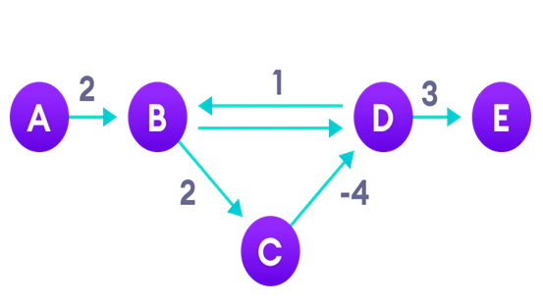
Why do we need to be careful with negative weights?
Negative weight edges can create negative weight cycles i.e. a cycle that will reduce the total path distance by coming back to the same point.
Negative weight cycles can give an incorrect result when trying to find out the shortest path

Slide 6
Bellman Ford Pseudocode
function bellmanFord(G, S)
for each vertex V in G
distance[V] <- infinite
previous[V] <- NULL
distance[S] <- 0
for each vertex V in G
for each edge (U,V) in G
tempDistance <- distance[U] + edge_weight(U, V)
if tempDistance < distance[V]
distance[V] <- tempDistance
previous[V] <- U
for each edge (U,V) in G
If distance[U] + edge_weight(U, V) < distance[V}
Error: Negative Cycle Exists
return distance[], previous[]

Slide 7
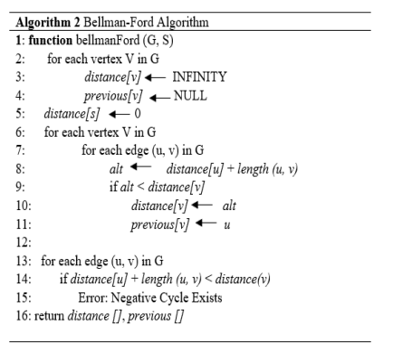

Slide 8
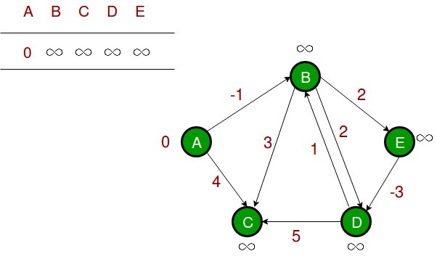
illustration of the above algorithm:
Step 1: Let the given source vertex be 0. Initialize all distances as infinite, except the distance to the source itself. Total number of vertices in the graph is 5, so all edges must be processed 4 times.

Slide 9
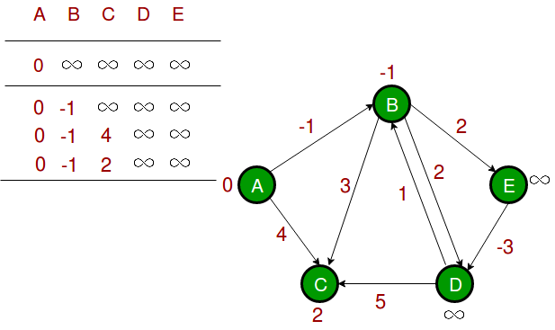
Step 2: Let all edges are processed in the following order: (B, E), (D, B), (B, D), (A, B), (A, C), (D, C), (B, C), (E, D). We get the following distances when all edges are processed the first time. The first row shows initial distances. The second row shows distances when edges (B, E), (D, B), (B, D) and (A, B) are processed. The third row shows distances when (A, C) is processed. The fourth row shows when (D, C), (B, C) and (E, D) are processed.

Slide 10
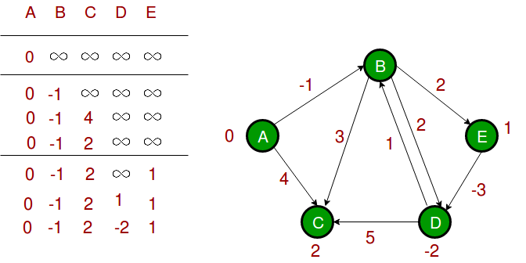
Step 3: The first iteration guarantees to give all shortest paths which are at most 1 edge long. We get the following distances when all edges are processed second time (The last row shows final values).

Slide 11
Step 4: The second iteration guarantees to give all shortest paths which are at most 2 edges long. The algorithm processes all edges 2 more times. The distances are minimized after the second iteration, so third and fourth iterations don’t update the distances.

Slide 12
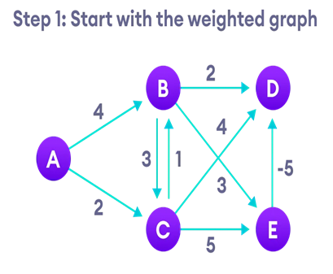
Bellman Ford algorithm works by overestimating the length of the path from the starting vertex to all other vertices. Then it iteratively relaxes those estimates by finding new paths that are shorter than the previously overestimated paths.
By doing this repeatedly for all vertices, we can guarantee that the result is optimized.

Slide 13
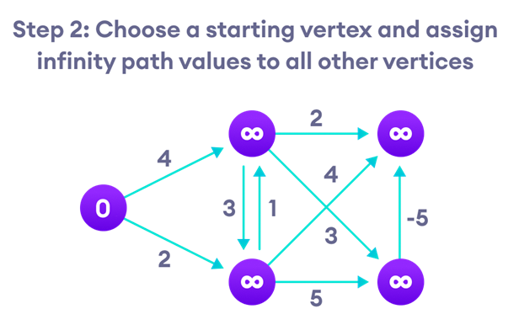

Slide 14
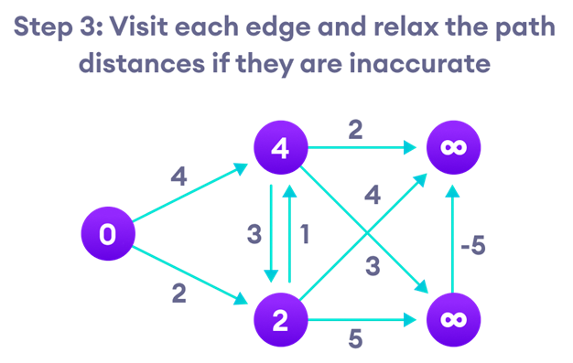

Slide 15
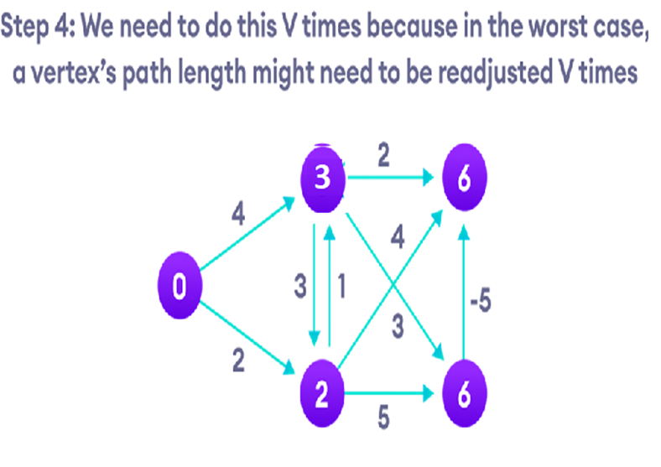

Slide 16
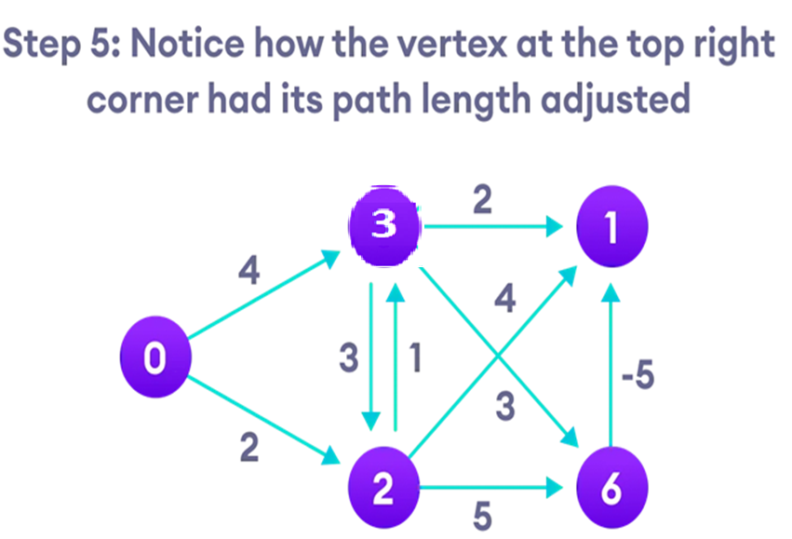

Slide 17
